Slide 1

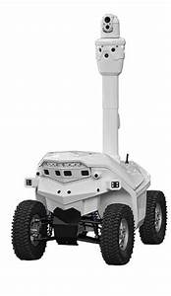
Design and Implementation of Patrolling Robot for Women Safety
Name of Students: Roll No:
Sonali Pangavhane 33
Nikita Shinde 44
Divya Lahire 24

Slide 2
Problem Definition why Patrolling Robot for women safety??
Women occupy almost half the globe. But their survival has always been Women are the subject of exploitation inside and outside the home say whether on roads, trains, cabs, schools etc. a question, when it comes to existence with honour and dignity. Women’s empowerment in the country can be brought once their safety and security is ensure, either it may be at home, alone places or during travelling.
Solution to the problem: The level of security can be increased more by safety robot, which can track the area , and ensure she has completed journey without any problems, this will not only make them safe but their parents, kids or husbands will also feel stress free.

Slide 3
Scope and Objectives
Objective
This system for individuals to avoid crimes in alone or being in badly lit areas.
Implementation of a real time monitoring device can solve the problem to an extent.
The basic approach is to intimate instant location and a distress message to the cops and registered number like parents, friends, media, and women cell etc. so that unfortunate incidents would be averted and to provide real time evidence for swift action against the perpetrators of crime against women
Future scope
There are numerous enhancements to the current design and technology that can be made, as well as numerous extra features that may be introduced.
Different types of sensors, such as temperature sensors, pressure sensors, heat sensors, position sensors, and proximity sensors, can be used to use robots in many fields.
A wireless network can be used to create a multipurpose robot, with applications ranging from surveillance and home security to industrial applications where the user does not need to be.

Slide 4
Literature Review
There is a need to develop a device that can detect the operation in this area and send the inspection device nearby a message. Within this framework, they render a spy robot using Raspbian operating system with remote monitoring and control algorithm. The spy robot system is connected to three types of equipment including a Arduino board, a camera and a night vision sensor.
The information collected about the activities that operate on the front of the camera is sent to users via the web server which can be posted simultaneously on the web page. It has given diverse road detection ideas and different monitoring concepts.
Road and street surveillance is also very important to conduct various activities such as identification of pedestrians, any suspicious behaviour, etc. This system grades the pixels of the route image. Various projects are planned for daytime activities so far but no such work is done for night. This technology centers the identification for any insufficient night-time practices.
As this device is based on vision and can discern the path according to the view, when some other thing, as for birds or car, get inside the photo it will face difficulty. Here a planar reflection model is practical with an infrared camera to distribution of the strength of the different pixels.
The scope of visibility, a complex source of light, speed highlights etc. are among these different challenges.

Slide 5
Methodology
Node MCU is equipped with the night vision camera that helps the user to go for automation and helps to find the person or any problem detected using the sound sensor and automatically goes to that area and captures the image and sends it to the user using IOT technology according to the sound generated. The robot has a range of knowledge to protect the greater region.
Microphone is used to detect sounds in the real time and send them to the monitoring system. The live photos and videos are recorded by the vision system. Two generators are enough to power the module for robot movement. Because the number of gears in the motor is small, less power consumption will be received. This robot will be moving front and backwards using infrared sensors with the help of wheels with the use of Dc engine.
There is a sound sensor using in the robot. This sound sensor will sense the sound with the particular frequency and after sensing the sound the robot will move towards the sound recognized side and the camera will be switched on and the camera will record the video with the audio file.

Slide 6
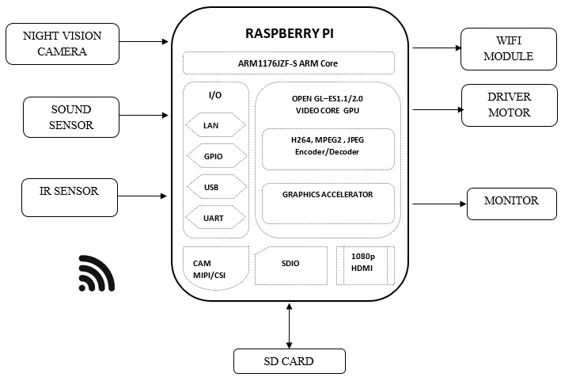
Block Diagram/Architecture

Slide 7
Project Planning
Installation of Raspberry PI with night vision camera.
Installation of navigation system.
Implementation of components.
Designing of sound sensor and DC motor.
Designing of Monitoring system.

Slide 8
References
“Review of human detection techniques in night vision” in 2017 International Conference on Wireless Communications, Signal Processing and Networking (WiSPNET)
[2] Eun Som Jeon et al., "Human detection based on the generation of a background image by using a far-infrared light camera", Sensors, vol. 15, no. 3, pp. 6763-6788, 2015.

Slide 9


